Slide 1
Timecard & Adjustments Process
AppsNA CSD Operations

Slide 2
Content
Timesheet Adjustments
Timesheet Submission, proxy & follow-up process
Adjustments process flow
Adjustments Types
Adjustments process steps
Adjustment Timecards for Resigned & Abscondee resources
Key Points to consider

Slide 3
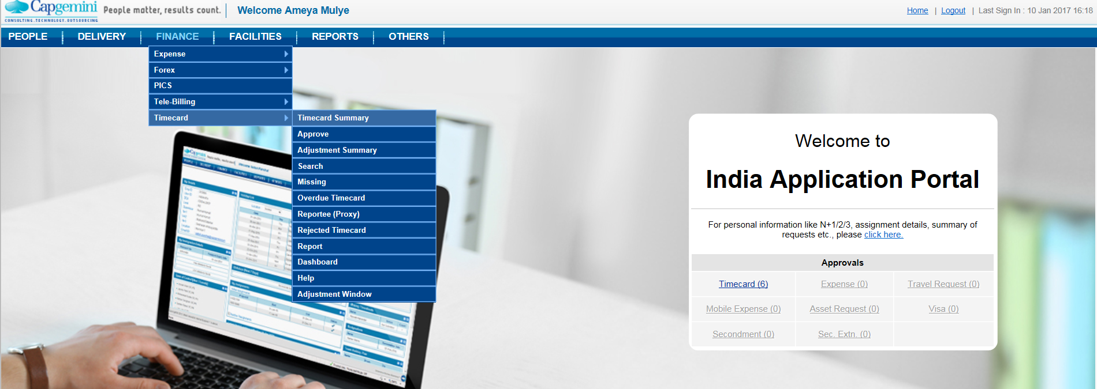
Timesheet Submission, proxy & follow-up process
Resource has to fill timecard on weekly basis as mandatory process every month. If code is not assigned they have to reach out to respective RMG’s to get their code assignment done. Finance Team usually sends the notification for monthly timecards closure which is between the period 20th to 28th of every month. Resource needs to make sure all timecard are submitted and approved for respective month by their supervisor. Failing to do will results in adjustments which will required BU Head approval & to follow process shown in further slides.
Below is the link to submit Timecards: http://indiaapps.in.capgemini.com/Aspxpages/Applications.aspx#

Slide 4
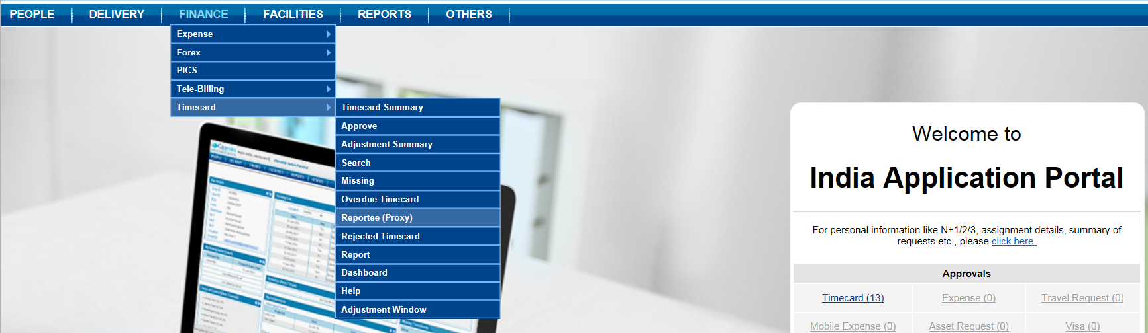
Continued…
Steps followed for MTS closure
On weekly basis RMG has to drop reminders in 3 categories depending upon the timecards status. First category consist of Not filled, rejected, saved. Second category consist of EmpAdjSubmitted & Submitted & Third category consist of AdjSubmitted for which supervisor needs to provide the reasons for making Timecard adjustments
In second follow up process we have to initiate a mail which includes Accounts leads and respective PM’s for that project. So accordingly the pending & defaulters list been shared with them for Timecards.
Proxy for Timecards
In case resource is absent respective supervisor has to proxy timecard on his N’s behalf. And supervisor’s supervisor can approve the timecards and chain process can be followed accordingly.

Slide 5
Adjustments Process Flow
Resources filling Timecards on billable code & later adjusting their Timecards against non billable code due to below reasons.
Reasons for Adjustments
Adjustments against planned/unplanned leave
Task change as requested by Leads
Hours, Billability change.
Adjustment due to change in Shift
Adjusted Timecards goes in Supervisor’s queue followed by BU head approval finally
Billable Code Adjustment
Resource Timecard
Adjustments has to be done in Timecard Adjustment portal – Adjustment Summary Tab
Resources filling Timecards on Non billable code & later adjust their Timecards against billable code due to below reasons.
Reasons for Adjustments
Adjusting non billable Task against billable Task, billability change.
Adjustment due to change in project Codes
Adjusted Timecards goes in Supervisor’s queue for approval finally
Non Billable Code adjustment

Slide 6
Adjustments Types
Below Adjustments can be cleared only from Adjustment Summary Tab window from Timecard portal
Link for Adjustment Window: http://indiaapps.in.capgemini.com/Aspxpages/Applications.aspx#
AdjSaved - Timecard adjustment saved by the supervisor, Pending to be submitted by supervisor.
AdjSubmitted - Timecard adjustment approved by supervisor, Pending with BU Head for approval.
AdjReturned - Timecard adjustment returned by BU Head, need to be submitted by Employee\Supervisor again.
Emp AdjSubmitted - Timecard adjustment submitted by the Employee, Pending with supervisor for approval.
Emp AdjSave - Timecard adjustment saved by the Employee, Pending to be submitted by Employee.
Emp AdjRejected - Timecard adjustment rejected by Supervisor, need to be submitted by Employee again.

Slide 7
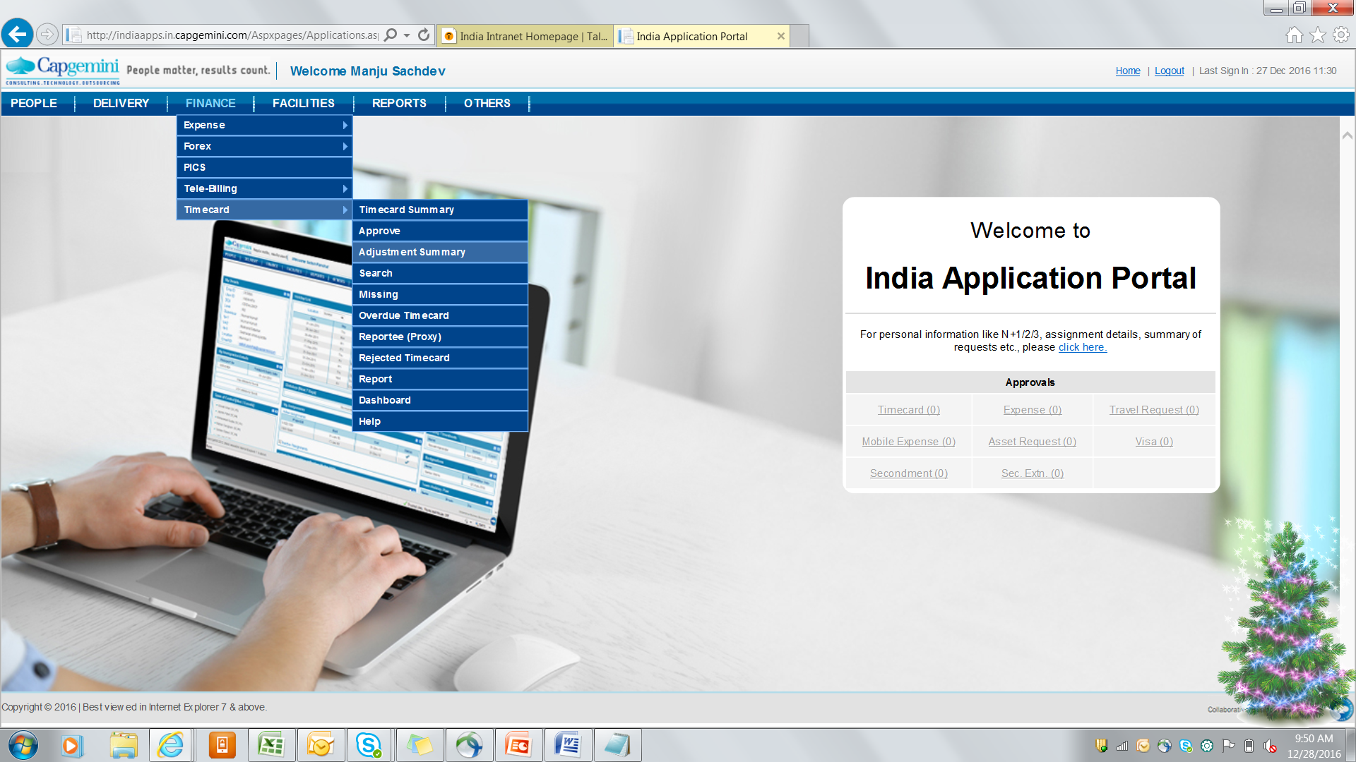
Adjustment Process steps
Billable Code Adjustments (BT to NBT)
Resources doing adjustments in Timecard portal from Billable code to non billable code falls under above category. Any adjustments done by resources due to reasons mention in previous slide goes to Supervisor’s queue. On weekly basis respective RMG Team consolidates the reason for adjustments and share the same with BU head (Clifton Menezes) for approval.
Link to follow for checking Adjustments Timecards: http://talent.capgemini.com/in/

Slide 8
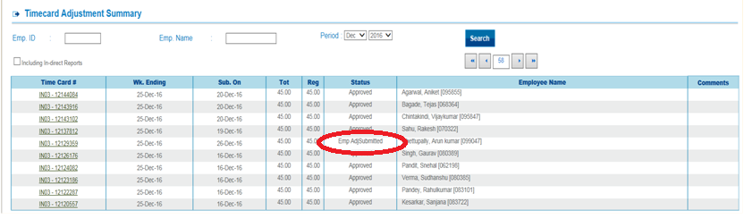
Adjustment Process contd….
In adjustment Summary Tab adjustments done by resources gets approved in the system once the consolidated reasons list has been shared with them.
Non Billable Code Adjustments (NBT to BT)
Resources doing adjustments in Timecard portal from non billable code to billable code falls under above category. Any adjustments done by resources due to reasons mention in previous slide goes to Supervisor’s queue. In this case mostly EmpAdjSubmitted is reflecting in timecard portal. Also supervisor has to validate the Period & weekending for which he approves timecard along with updating comments.

Slide 9
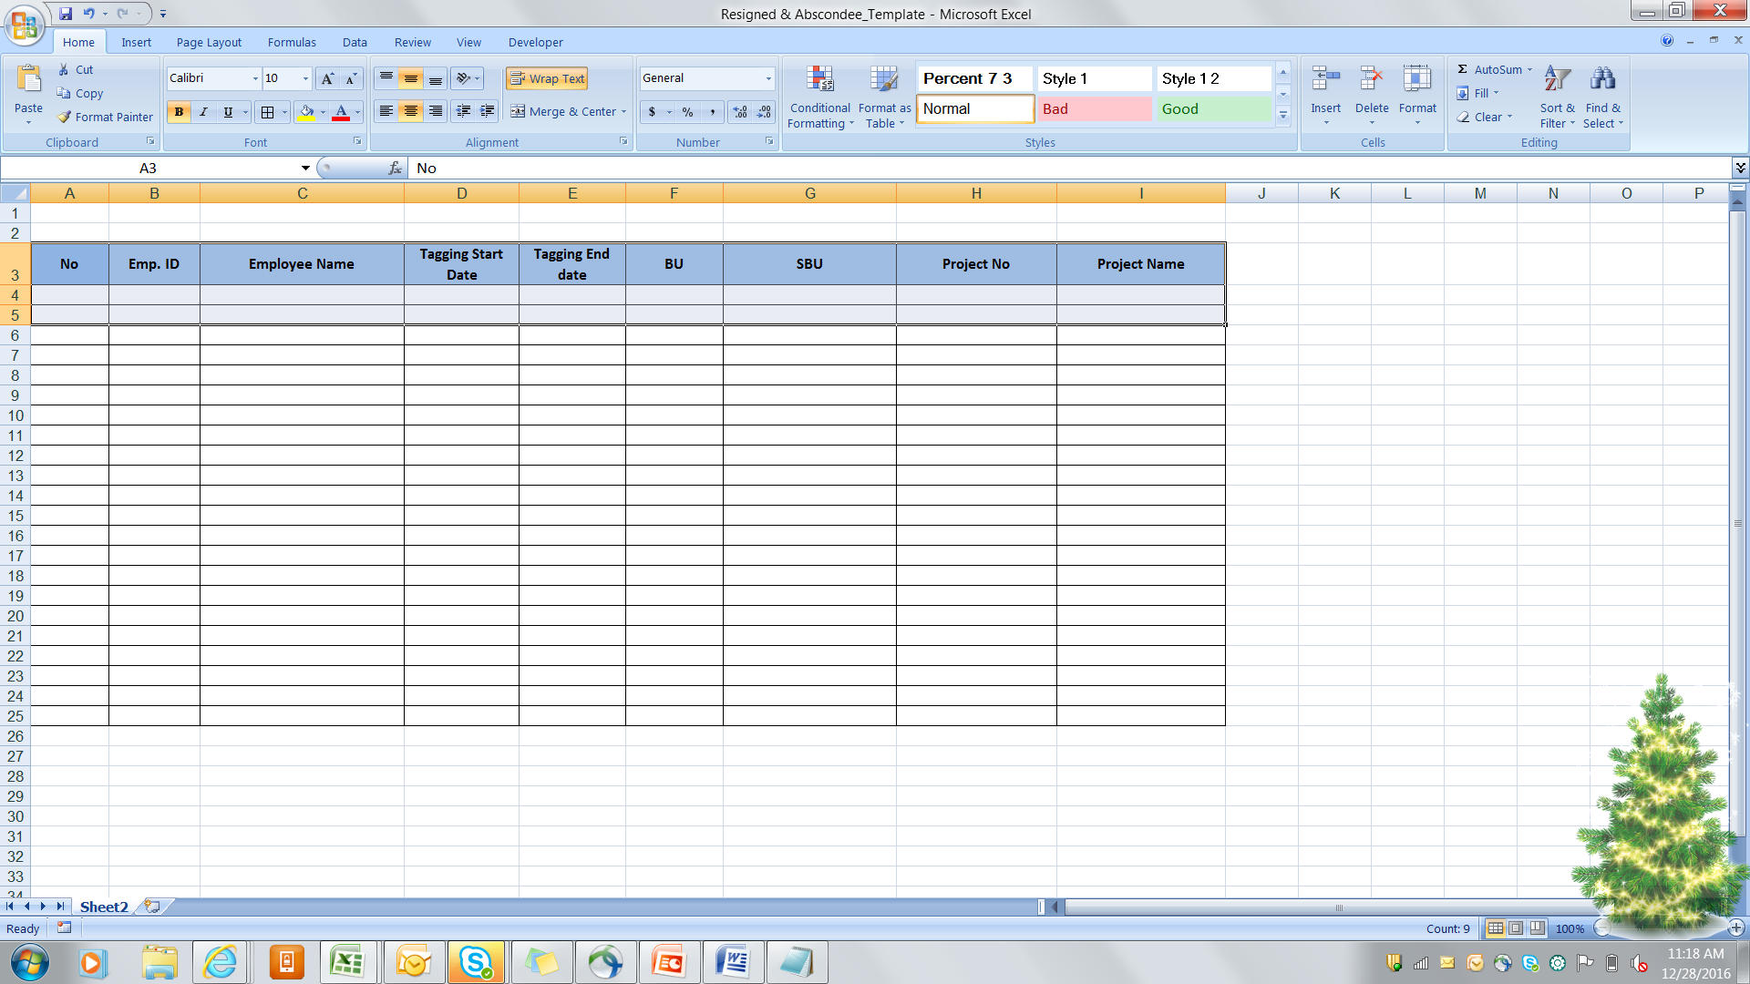
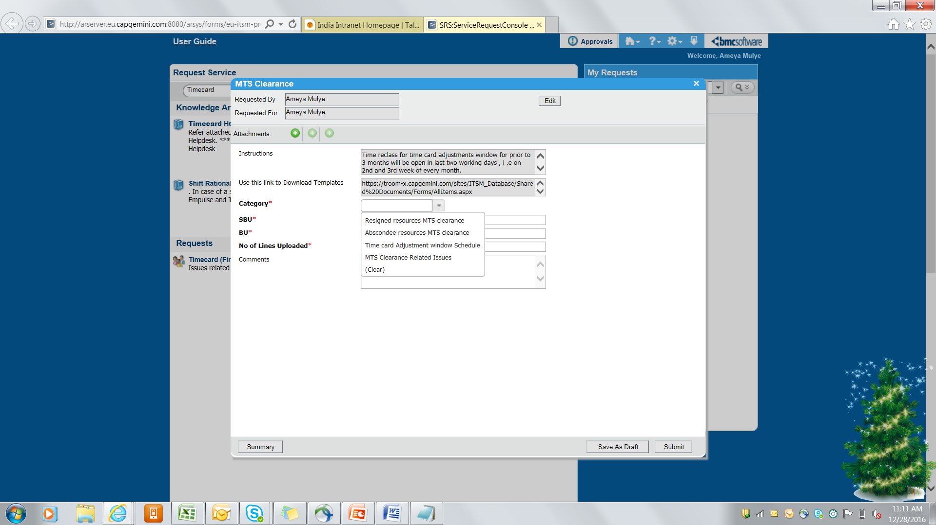
Resigned & Abscondee Timecards
Timecard for resigned & Abscondee cases can be closed by following below steps. We need to share the template with our respective finance BU controller in below format. After updating the details in above format, we have to raise Ticket in India Service Desk under category shown

Slide 10
Key points to consider
Adjustments Timecard prior to 3 months can be closed only when finance controller Team opens a window every month for particular time frame. (2 to 3 days)
Monthly Timecards has to be closed week-wise which minimizes efforts to work on Year to date (YTD).
All AdjSubmitted timecards has to be approved by (BU head) only after having valid reason for adjustment.
For resigned & abscondee cases supervisor has to make sure before giving go ahead for Exit formalities his Timesheets for entire year is approved in the system.

Slide 11
Thank you!
Any Questions? Please feel free to connect with us

